Slide 1
BMLT 115 BASIC SAFETY RULES IN THE LABORATORY
BY: ALFRED AFRIYIE ASIEDU

Slide 2
OBJECTIVES
By the end of this lecture, students should be able to;
Understand the importance of safety in the laboratory
Identify potential hazards in the laboratory environment
Learn and apply basic safety rules and protocols
Demonstrate proper use of personal protective equipment (PPEs)
Respond appropriately to emergencies and accidents in the laboratory

Slide 3
LABORATORY SAFETY RULES
Laboratory safety rules are a major aspect of every scientific lab, be it Medical, Research, Teaching, etc., and every user of the lab (personnel, student, guest) must adhere to these safety protocols.
Why are Lab safety rules important?
Prevent and protect everyone from accidents such as chemical injuries, equipment, and/or physical hazards
Prevent environmental contamination; through spillage, leakage or wrong disposal
Adhering to safety rules helps in emergency preparedness
Adhering to safety measures fosters productivity, accurate results, and improves morale
Preventing accidents and injuries reduces the cost incurred through medical treatments, equipment repairs, and potential legal liabilities

Slide 4

POTENTIAL HAZARDS IN THE LABORATORY
BIOLOGICAL HAZARDS
These hazards arise from exposure to infectious biological agents such as bacteria, viruses, fungi, parasites, etc. and biological samples such as blood, urine, tissues, etc.
Kinds of biological hazards include;
Bloodborne pathogens: Hepatitis B & C virus, HIV, plasmodium, Treponema pallidum (Syphilis), etc.
Bloodborne pathogens can be transmitted through needles or sharp objects, contact, assaults, splashes, ingestion.
Airborne pathogens: Mycobacterium tuberculosis, Coronavirus.
These pathogens can be transmitted through small respiratory droplets (coughing, sneezing, spitting, close contact).
3. Zoonotic agents: Rabies virus, Ebola virus, Salmonella, Bacillus anthracis, zika virus, etc.
Zoonotic diseases can be transmitted in the medical lab through direct contact with infected specimens, indirect contact (contaminated lab surfaces), inhalation of infectious droplets, bites from infected lab insects such as mosquitoes.
Notes:
HAZARDS VS RISKS
HAZARD is a potential source of any form of harm
RISK is the probability or likelihood that a harm would occur

Slide 5
CHEMICAL HAZARDS
Any form of chemical including medications, solutions, gases, vapours, aerosols, etc. that are potentially toxic or irritating to the body.
Forms of chemical hazards
Corrosive chemicals: Examples include acids, alkalis
Toxic chemicals: formaldehyde, cyanide, chloroform
Flammable chemicals: ethanol, acetone
Carcinogens: benzene, ethylene oxide, ethidium bromide
Chemical hazard risk factors
Acute Toxicity: Immediate effects after short-term exposure. Example: Cyanide, formaldehyde
Chronic Toxicity: Long-term exposure leading to diseases. Example: Benzene may cause leukaemia, flame retardant like Polybrominated diphenyl ethers (PBDEs) may cause infertility in men.
Irritation & Corrosion: Skin, eye, respiratory irritation. Example: Acids, ammonia, chlorine, fumes.
Mutagenicity & Birth defects: Ethidium bromide, mercury, lead
Notes:
Polybrominated diphenyl ethers (PBDEs) – Flame retardant added to furniture, plastics, textiles, electronics, to slow down ignition or spread of fire.

Slide 6
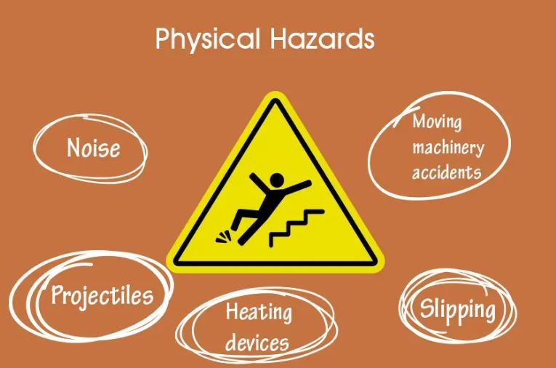
PHYSICAL HAZARDS
They include risks from equipment, tools and environmental factors
Examples
Sharp object (needles, broken glass)
Electrical hazards (faulty wiring, overloaded socket, voltage problems)
Noise from laboratory equipment such as centrifuge, qRT-PCR machines
Extreme temperatures in the lab as a result of autoclaves, freezers, oven
Wet floors or surfaces through liquid spillage
Risks from Physical hazards
Cuts, punctures, lacerations from sharp objects
Electrical shocks and burns
Hearing damage from prolonged exposure to noise
Burns from hot surfaces or cryogenic materials
Injuries from slipping

Slide 7
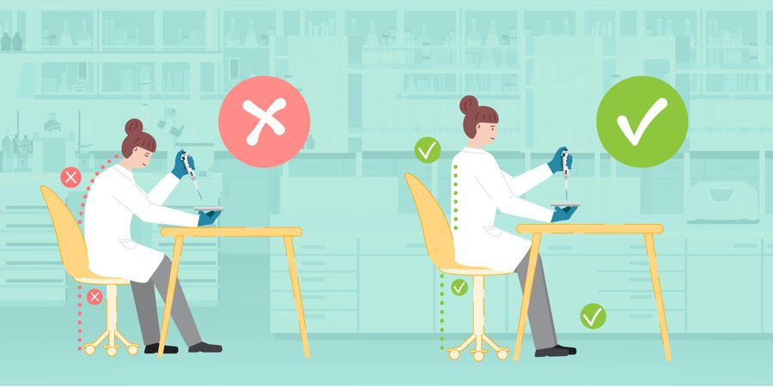
ERGONOMIC HAZARDS
Any physical factor in the lab such as repetitive tasks, poor workstation, improper ways of lifting heavy materials, etc. that could cause musculoskeletal injuries.
Examples
Prolonged pipetting or microscope use
Lifting of heavy materials
Poor sitting posture
Poor workstation design
Risks Involved
Repetitive strain injuries like carpal tunnel syndrome
Back or joint pains
Fatigue and reduced productivity
Notes:
carpal tunnel syndrome (CTS) - a condition that occurs when the median nerve in the wrist is compressed. This can cause pain, numbness, tingling, difficulty grasping or holding small objects and burning in the hand and fingers.

Slide 8
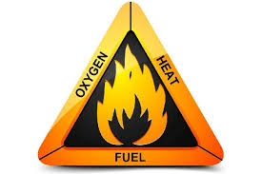
FIRE AND EXPLOSION HAZARDS
Flammable solvents chemicals or substances in the laboratory can pose fire and explosion risks
Examples
Improper storage of flammable solvents like alcohol
Bunsen burner
Overloaded sockets
Accumulation of static electricity can serve as an ignition source
Key elements of fire and explosion hazard
Heat (ignition)
Fuel (flammable or combustibles)
Oxygen
Risks
Burns or injuries
Damage to laboratory equipment and infrastructure
Notes:
FIRE TRIANGLE
Heat: The energy that causes a fire to start. Heat can be natural, like lightning or the sun, or man-made, like cooking appliances or matches.
Fuel: A flammable material that combusts when heated.
Oxygen: An oxidizing agent that fuels the chemical reaction that creates fire.

Slide 9
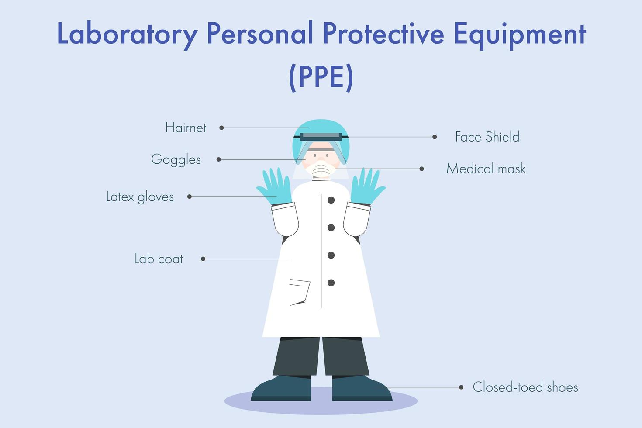
LABORATORY SAFETY RULES
Wear full protective clothing
Lab coat
Hand gloves
Facemask or shield
Goggles/safety glasses
Shoes
Do not wear sandals or slippers in the laboratory
Safely dispose off gloves
Fully button lab coats
Do not wear loose or baggy clothing
Tie long hairs and remove hanging jewelleries

Slide 10

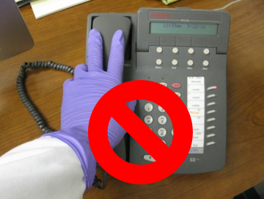
Avoid touching objects such as cell phones, door handles, bags, etc. while wearing gloves.
Do not put pencils, pens, or sheets in your mouth
Do not eat or drink in the lab
Do not keep food in the lab

Slide 11
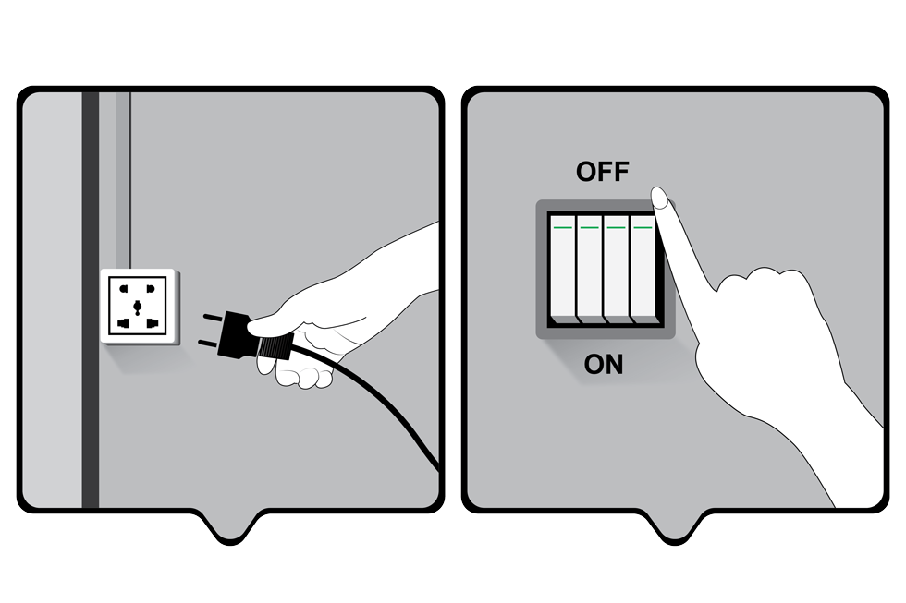
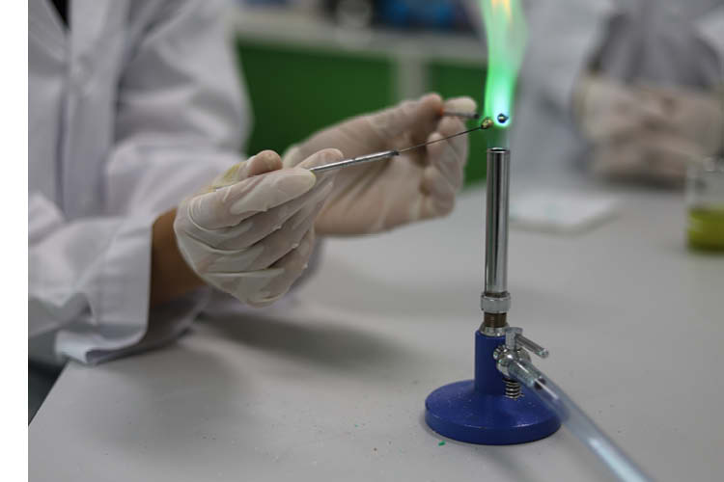
Turn off gas burners after use
Unplug electrical equipment after use
Keep electrical cords and instruments away from water or liquids

Slide 12
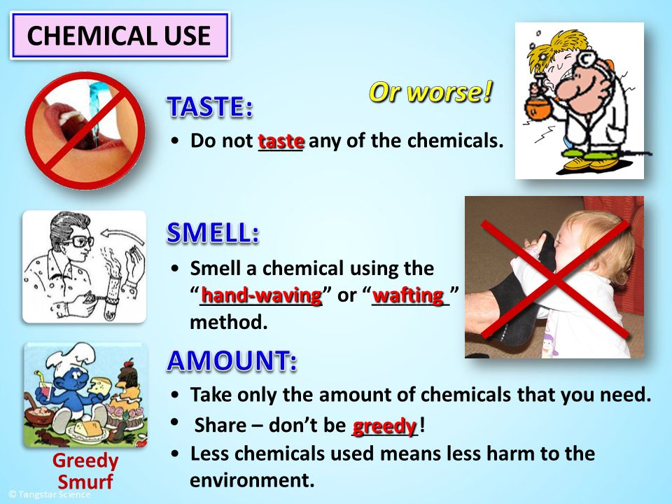

Never touch, taste or smell a chemical in the lab
Avoid mixing chemicals unless told to do so
Close or seal chemical containers after use

Slide 13
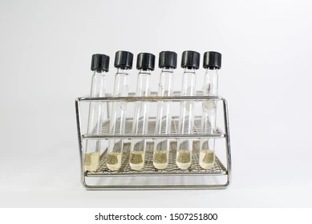
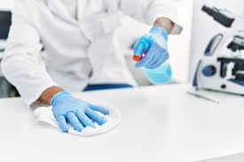
Do not take cultures out of the lab
Handle all cultures carefully since they are potentially pathogenic
Keep liquid cultures and test tube rack to prevent spillage
Wash your hands before and after every lab session
Do not engage in practical jokes or horseplay
Keep nonessential books, bags, and other materials away from your work area
Always disinfect benches and workspace by wiping with disinfectant, before and after work
Dispose off waste according to instructions
Report all accidents to the supervisor in the lab

Slide 14
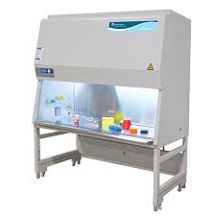
SAFETY EQUIPMENT IN THE LAB
BIOSAFETY CABINET (BSCs)
Enclosed, ventilated workspaces in the laboratory designed to protect personnel, samples, and the environment from biological hazards
Types of Biosafety cabinets
Class I – Protects the personnel and the environment but not the sample
Class II – Protects the user, sample, and environment (most common in medical labs)
Class III – Provides maximum protection for highly hazardous agents
Notes:
HEPA FILTRATION CONCEPT – HEPA filter in BSCs I filters particle size of 0.3 microns.
Note that, according to the Kinetic Theory of gases, the size of individual gas particles like those in air is considered to be essentially ZERO.
Also, the size of a sand grain is 63 microns or more.
The size of coronavirus averages around 2.5 mircrons

Slide 15
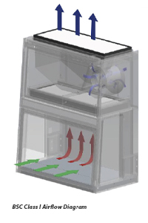
CLASS I - BIOSAFETY CABINET AIRFLOW
Inward Airflow – Room air is drawn into the cabinet through the open front, pushing airborne contaminants away from the operator
HEPA filtration – the air is pulled through the filter, where it traps 99.97% of particles that are 0.3 microns in size
Exhaustion – the filtered air is exhausted outside the cabinet, either back into the room or through an externally connected duct
Notes:
Class I – Only provides protection for the user and environment
Limitations – 1. Does not provide protection for the sample.
2. Cannot work on pathogenic microbes in this cabinet

Slide 16
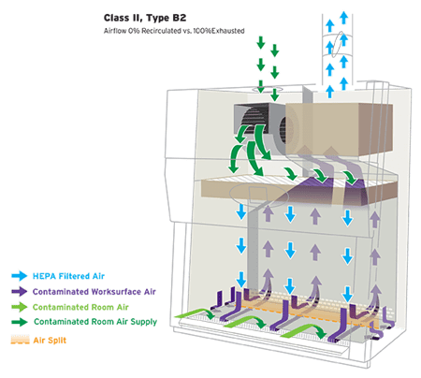
CLASS II – BIOSAFETY CABINET AIRFLOW
Inward airflow – air in the room is drawn into the cabinet through the front open, preventing airborne contaminants from escaping
Downward laminar airflow – HEPA-filtered air flows vertically downward, protecting the sample from contamination
HEPA filtration – both incoming air and exhaust air are filtered through the HEPA filter to remove airborne particles before being recirculated or exhausted outside
Notes:
Class II - provides protection for the sample, user, and environment
Limitation – highly pathogenic microbes require higher safety cabinet

Slide 17
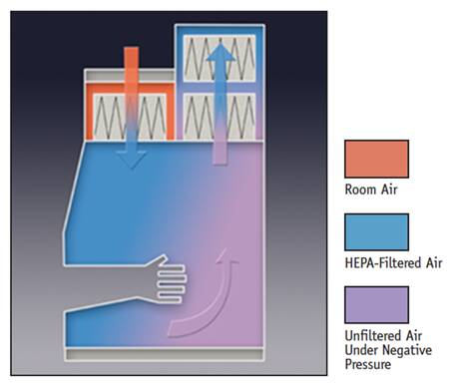
CLASS III – BIOSAFETY CABINET AIRFLOW
Fully enclosed system – the cabinet is totally sealed from the environment. Work is conducted through a glove box attached to the cabinet
HEPA-filtered air supply – Clean, HEPA-filtered air enters to maintain a sterile working environment. Thus, both incoming and exhaust air are filtered to remove airborne particles
Negative pressure – the cabinet operates under negative pressure to ensure air flows inward, while protecting the operator and the environment
Double HEPA-filtered exhaust – exhaust air is safely discharged to the environment through double HEPA filters, thus ensuring complete containment of hazardous agents
Notes:
Class III – provides protection for the environment, sample, and operator against highly pathogenic microbes

Slide 18
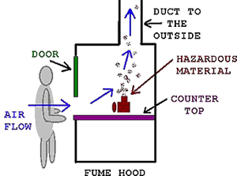
FUME HOOD
A ventilated enclosure that protects the operator from hazardous fumes, vapours, dust, and airborne contaminants through controlled air flow.
When to use a fume hood?
When working with volatile liquids or chemicals
When working with toxic compounds
When working with compounds with a boiling point below 120 degrees Celsius.
Airflow mechanism
The hood pulls air away from the user into the enclosure with a blower. The fume hood then filters the air and exhausts it through the outdoor system
Notes:
FUME HOODS only protects the user.
Fume hoods are used for chemical fume capture while BSCs are used for pathogen handling

Slide 19
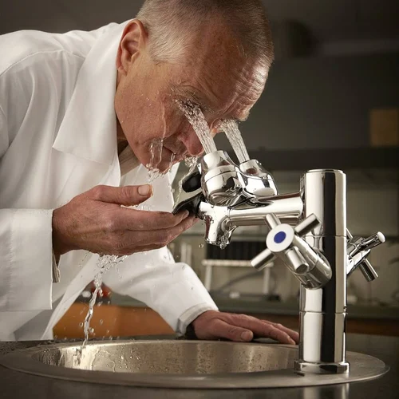
EMERGENCY SHOWERS AND EYEWASH
Critical for immediate decontamination of chemical spills and splashes
Emergency showers – to rinse chemicals off the body
Eyewash stations – used to wash chemicals or debris from the eyes
Chemical Spill Kits
Contain materials to safely clean up chemical spills
It contains absorbent materials like wipes, neutralizing agents for acids or bases, PPE such as gloves, Disposal bags and containers
Notes:
Emergency shower must be very close to the hazard area

Slide 20

FIRE SAFETY EQUIPMENT
Essential for controlling fires in the laboratory;
Fire extinguishers
Fire blankets
Fire alarms and sprinklers
FIRST AID KIT
Provides basic supplies for treating minor injuries in the laboratory
It contains items such as antiseptic wipes, ointments, burn cream, scissors, bandages, gauze, adhesive tape, painkiller, etc.
PERSONAL PROTECTIVE EQUIPMENT (PPE)
First line of defense against laboratory hazards.
It includes lab coats or coveralls, gloves, safety goggles or face shields, masks or respirators, closed-toe shoes, etc.

Slide 21
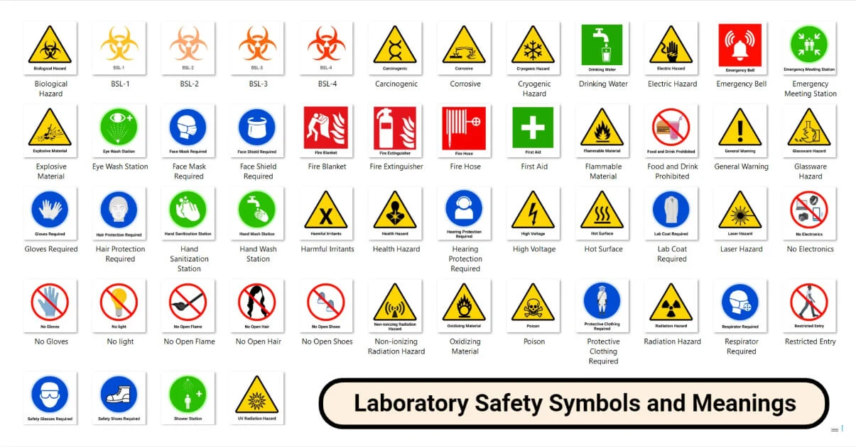
LABORATORY SAFETY SYMBOLS

Slide 22
BIOSAFETY LEVELS IN THE LABORATORY
BSL are set of safety precautions/biocontainment precautions designed to protect laboratory personnel, the environment, and public from potentially hazardous biological agents used in a scientific lab.
There are 4 biosafety levels categorized based on risk being associated with the microorganisms being handled.
BSL-1 – LOW RISK
Handles non-harmful microbes (E.coli, pseudomonas, K-12, Bacillus subtilis, etc.
Basic PPE (lab coat, gloves)
Standard microbiological practices such as disinfection of surfaces, handwashing, no eating or drinking
No special containment required; work done on open benches
BSL-2 – MODERATE RISK (Pathogens with Treatment)
Handles mild disease-causing microbes such as Salmonella, Hepatitis A,B & C virus, Staphylococcus aureus, Human blood, tissues or cell lines
Requires the use of basic PPE including face protection if needed
Requires BSC-II for aerosol-generating procedures
Waste decontamination is required (autoclaves)
Facility design must have eyewash station and self-closing doors

Slide 23
BSL-3 – HIGH RISK (Serious Pathogens)
Handles airborne pathogens with potential for severe outbreak (Mycobacterium tuberculosis, SARS-CoV-2, Brucella, Bacillus anthracis, Coccidioides, West Nile virus, Chikungunya virus)
PPE includes N95 respirator or powered air-purifying respirator (PAPR)
Work conducted in BSC-II or III with negative pressure airflow and HEPA-filtered exhaust air
Access is strictly controlled
BSL-4 – EXTREME RISK (Deadly Pathogens with No Cure)
Handles highly lethal viruses (Ebola, Marburg, Lassa fever virus, hemorrhagic viruses found in the tropics)
High risk of aerosol transmission
Requires full-body proof PPE
All work inside BSC-III
Maximum containment with isolated lab structure, airlocks, dedicated air supply & exhaust

Slide 24
